Slide 1
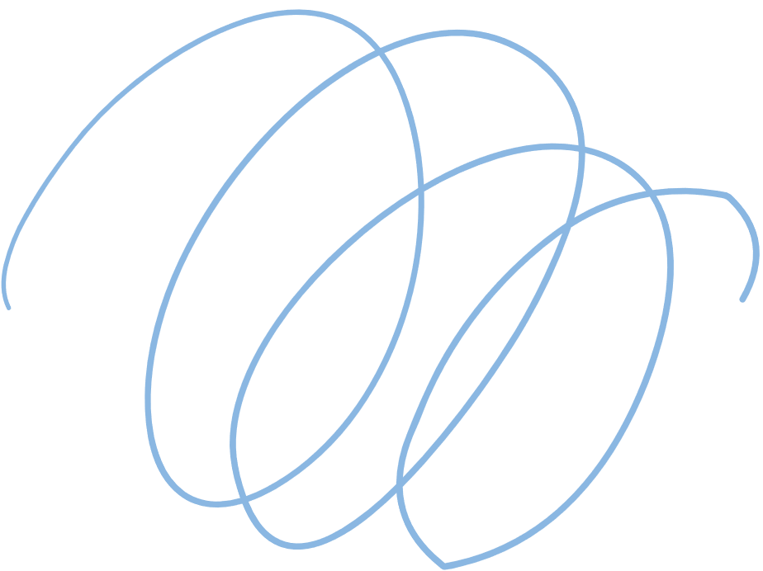













FIBONACCI SEQUENCE CALCULATOR
Iterative & Recursive

Slide 2
  AGENDA
01
02
03
04
Introduction to Fibonacci Sequence, it’s revelation and occurences.
Fibonacci Calculator, it’s Iterative and Recursive approach, and their contiguous comparison.
Advantages & Disadvantages of both approaches. Their Time Complexities, best approach etc.
Real life Applications
of Fibonacci Calculator and conclusions.

Slide 3

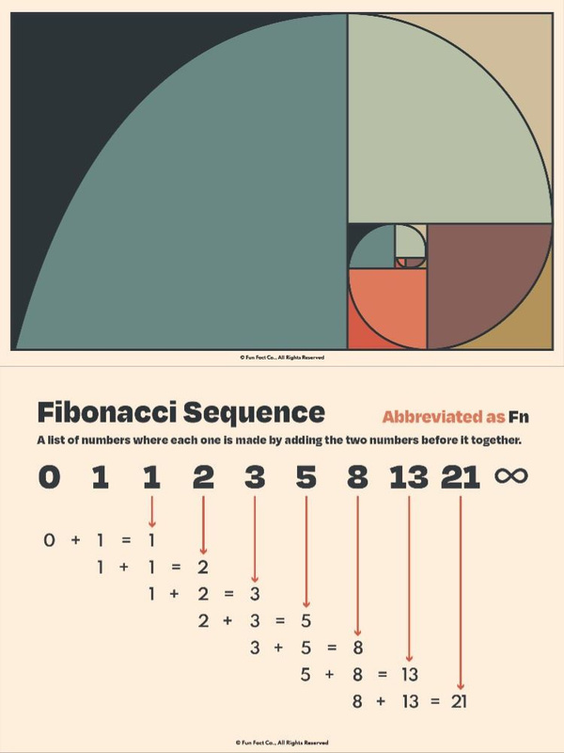
FIBONACCI SEQUENCE
The Fibonacci sequence, also known as Fibonacci numbers, is defined as the sequence of numbers in which each number in the sequence is equal to the sum of two numbers before it. The Fibonacci Sequence is given as:
0, 1, 1, 2, 3, 5, 8, 13, 21, ….
Fibonacci Sequence Formula :
The Fibonacci sequence of numbers “Fn” is defined using the recursive relation with the base values F0=0 and F1=1:
Fn = Fn-1+Fn-2

Slide 4
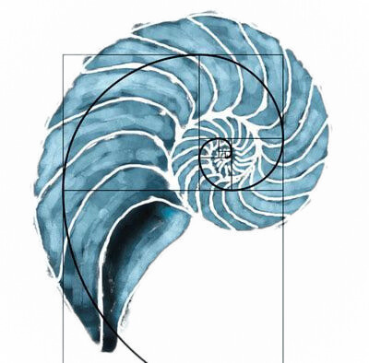
DISCOVERY
The Fibonacci Sequence first appears in Liber Abaci (1202) by Fibonacci who introduced the sequence to model rabbit population growth, assuming ideal conditions with no death and constant breeding after the second month.
OCCURENCES
The Fibonacci sequence appears in nature (flower petals, seed arrangements and shells etc.) and various fields like mathematics, art, architecture, finance, music, and computer science, reflecting its importance in growth patterns, symmetry, and optimization across disciplines.

Slide 5
COMPARISSON BETWEEN TWO APPROCHES
ITERATIVE
RECURSIVE
Iterative fibonacci(n)
if n = 0 then return 0
else x := 0 y := 1
for i := 1 to n − 1
z := x + y
x := y
y := z
return y
fibonacci(n)
if n = 0 then return 0
else if n = 1
then return 1
else return
fibonacci (n − 1) +
fibonacci (n − 2)
{output is fibonacci(n)}

Slide 6
Advantages of the Iterative Method
Straightforward Implementation
Improved Performance
The iterative approach is
easier to understand and
implement, especially
for beginners.
Iterative methods often have better time and space complexity compared to recursive solutions.
Iterative algorithms are generally more straightforward to debug and maintain.
Iterative methods typically require less memory than their recursive counterparts.
Memory Efficiency
Easier Debugging

Slide 7
Advantages of the Recursive Method
Recursive solutions often mirror the mathematical definition of a problem more directly.
Recursive algorithms can provide a clearer understanding of the underlying problem structure.
Concise and Intuitive
Easier to Understand
Recursion is a powerful technique that can be applied to a wide range of problem domains.
Recursive implementations can often result in more elegant and expressive code.
Versatility
Elegant Code

Slide 8
Disadvantages of the Iterative Method
Iterative solutions may not capture the inherent structure of certain problems as elegantly as recursive approaches.
Potential for Errors
Limited Expressiveness
Iterative algorithms can be more prone to off-by-one errors and other subtle bugs, especially as the problem size grows.
Iterative methods may struggle to solve problems that have a natural recursive definition.
Iterative algorithms may require more memory to store intermediate results, particularly for large inputs.
Difficulty with Recursive Problems
Higher Memory Consumption

Slide 9
Disadvantages of the Recursive Method
Recursive solutions are harder to grasp, especially for complex problems.
Increased Complexity
1
Recursive calls add setup and stack overhead.
Performance Overhead
2
Deep recursion risks stack overflow.
Risk of Stack Overflow
3
Recursion uses more memory, limiting inputs.
Memory Limitations
4

Slide 10
Real Life Applications
Fibonacci Retracement:
Random Number Generation:
Algorithm Optimization:
Traders use Fibonacci Retracement levels to identify potential support and resistance levels in stock prices. This helps in making informed trading decisions by predicting potential price reversals.
Fibonacci Calculators can be used in cryptographic algorithms to generate pseudo-random numbers, enhancing the security of encrypted communications. For example, Lagged Fibonacci Generator (LFG), Fibonacci Bit Generator (FBG) etc.
In Computer Science, formally algorithms and data structures use Fibonacci Calculators. Fibonacci heaps, for instance, are used in network optimization algorithms due to their efficient merging properties.

Slide 11
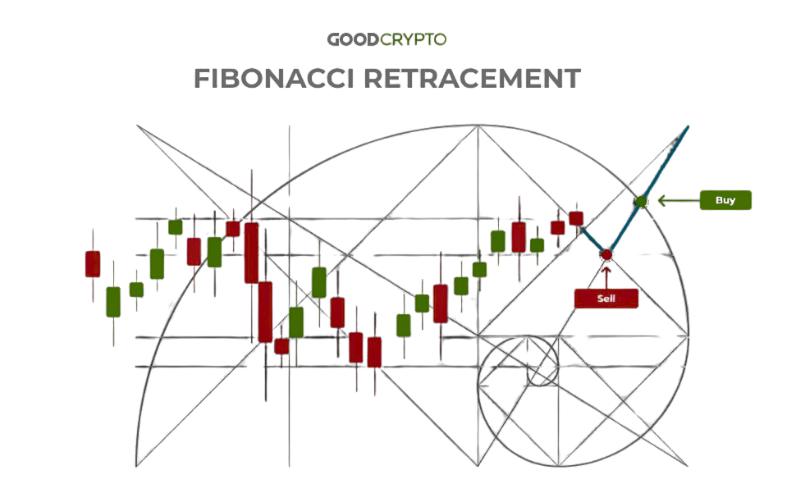
Fibonacci Retracement:
A Fibonacci calculator is a handy tool for applying Fibonacci retracement levels to your price charts without the manual effort. Here's how you typically
use it:
Input the High and Low Points:
Enter the highest and lowest price points of the
trend you're analyzing.
Generate Levels:
The calculator will automatically compute the
key Fibonacci levels (23.6%, 38.2%, 50%, 61.8%,
and 100%) based on the high and low points you've provided.
Plot the Levels:
These lines will help you identify potential
support and resistance levels.

Slide 12
Iterative Advantage
1
The iterative approach is the clear winner in terms of performance, particularly for larger input values.
2
Recursive Elegance
The recursive approach offers a concise and elegant representation of the Fibonacci sequence's mathematical definition.
3
Choosing Wisely
The optimal approach depends on the specific needs of your
application. For performance-critical scenarios, the iterative
approach is recommended.

Slide 13
Thank you very much!

